Slide 1
Favorable clinical phenotype reached in less than half of people treated in acute HIV infection
Jintanat Ananworanich, Suteeraporn Pinyakorn, Anchalee Avihingsanon, Jiratchaya Sophonphan, Carlo Sacdalan, Eugene Kroon, Donn Colby, Duanghathai Suttichom, Peeriya Prueksakaew, Sasiwimol Ubolyam, Rapee Trichavaroj, Mark de Souza, Nelson Michael, Merlin L. Robb, Praphan Phanuphak, Nittaya Phanuphak
on behalf of the RV254/SEARCH 010 and HIV-NAT 006 Study Groups
Acknowledgement
Participants in the RV254/SEARCH010 and HIV-NAT 006 studies
Investigators and sponsors

Slide 2
Disclosures
Jintanat Ananworanich has received honorarium for participating in advisory meetings for ViiV Healthcare, Merck, Gilead, AbbVie and Roche
Others declare no conflict of interest

Slide 3
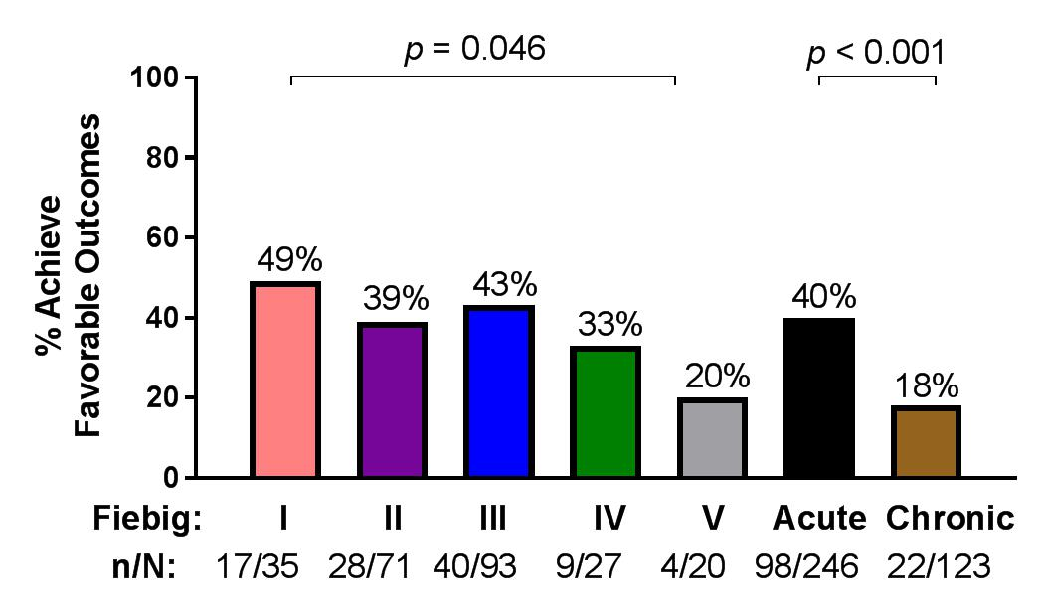
Favorable clinical phenotype after at least 2 years on ART
Definition of favorable clinical phenotype
No serious clinical events
No deaths
No AIDS-defining illness
No grade 4 adverse events
Latest CD4 > 500 cells/mm³
Latest CD4/CD8 ratio > 1
VL < 20 copies/ml at every visit after week 24

Slide 4
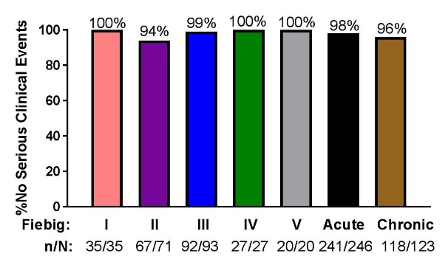
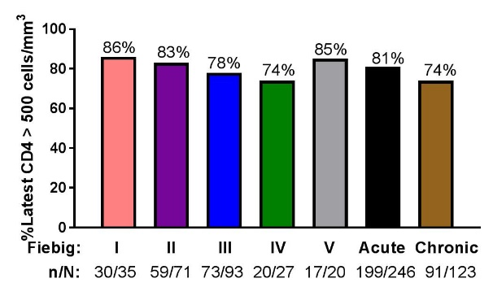
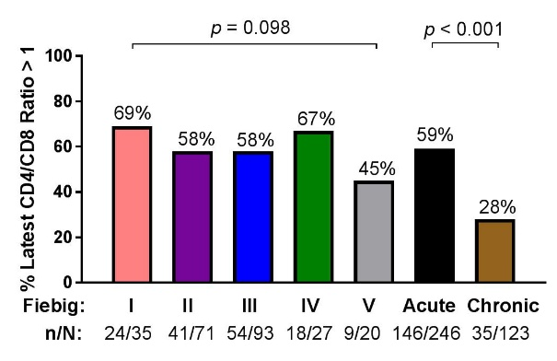
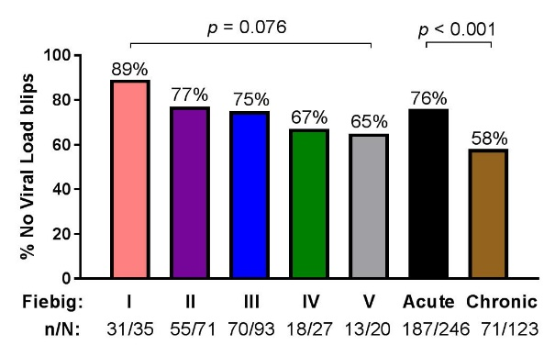
AHI treatment is associated with higher CD4/CD8 ratio and fewer viral load blips
No serious clinical events
Latest CD4 > 500 cells/mm³
Latest CD4/CD8 > 1
No viral load blips

Slide 5
Conclusion
Acute HIV infection treatment had higher rates of favorable clinical phenotype than chronic HIV infection
Despite initiating ART as early as Fiebig I/II seronegative AHI, less than half achieved a favorable clinical phenotype
Understanding the pathogenesis that distinguishes favorable vs. unfavorable clinical phenotypes may be important in improving therapy and developing HIV remission strategies

